Slide 1
Python Class 11 Series
Unit 1: Boolean logic
Saroj Kumar Jha
Saroj Codes
Please subscribe

Slide 2
Logical Operations
Truth table
Logic Gates
Theorem of Boolean algebra / logic
De Morgan's laws
and logic circuits

Slide 3






Development of Boolean logic
George Boole's Contribution: In the mid-19th century, George Boole, a mathematician and logician, developed a system called Boolean logic. Boole aimed to create a mathematical framework to represent logical relationships and reasoning.
Binary System: Boole's system operates on binary variables, which can have two values: True and False. In Boolean logic, True is typically represented as 1, and False as 0. This binary system forms the basis for representing and manipulating logical values.
Logical Operators: Boole introduced three fundamental logical operators: AND, OR, and NOT. These operators are used to combine or manipulate logical values.
AND operator: It represents logical conjunction and returns True only if both operands are True.
OR operator: It represents logical disjunction and returns True if at least one operand is True.
NOT operator: It represents negation and reverses the logical value of an operand.
Truth Tables: Truth tables are used to represent the output of a logical expression based on the inputs. They show all possible combinations of inputs and their corresponding outputs. By using truth tables, logical operations and their results can be easily understood and analyzed.

Slide 4
Development of Boolean logic
Applications: Boolean logic has numerous applications, especially in computer science. It forms the foundation for designing digital circuits and computer systems. Logical gates, such as AND, OR, and NOT gates, are used to build complex electronic circuits that process and manipulate binary information. Boolean logic is also fundamental in programming, where it enables decision-making processes and conditional statements.
Impact: Boolean logic revolutionized the field of computer science by providing a systematic approach to representing and manipulating logical values. Its applications in digital circuit design and programming are crucial for modern computer systems. Understanding Boolean logic is essential for developing logical thinking skills and solving problems in various disciplines.

Slide 5
Binary Valued Quantities
Binary System: The binary system is a numerical system that uses only two digits: 0 and 1. It is the foundation of all digital systems because it can represent information using only these two values.
Bits: In the binary system, the smallest unit of information is a bit (short for binary digit). A bit can have two possible values: 0 or 1. It is the basic building block of all digital data.
Binary Numbers: Binary numbers are numbers expressed in the binary system. They consist of sequences of 0s and 1s. Each digit in a binary number is called a bit. For example, the binary number 101101 represents the decimal number 45.
Representing Binary Valued Quantities: Binary valued quantities are used to represent various types of information in a digital system. Here are a few examples:
Binary-coded decimal (BCD): BCD is a way of representing decimal digits (0 to 9) using four bits per digit. For example, the decimal number 6 is represented as 0110 in BCD.
ASCII: The American Standard Code for Information Interchange (ASCII) is a character encoding scheme that uses 7 bits to represent characters. Each character is assigned a unique binary code. For example, the ASCII code for the letter "A" is 01000001.

Slide 6
Binary Valued Quantities
Images and Graphics: Images and graphics in digital systems are represented using binary valued quantities. Each pixel in an image is represented by binary values to determine its color or intensity.
Binary Operations: Binary operations, such as addition, subtraction, multiplication, and division, can be performed on binary valued quantities using specific rules. These operations follow the same principles as decimal arithmetic, but with the limited set of digits (0 and 1) in the binary system.
Binary Logic: Binary valued quantities are closely related to Boolean logic, which deals with logical operations involving True and False values (represented as 1 and 0 in the binary system). Boolean logic forms the foundation for designing digital circuits and logical operations in computer programming.

Slide 7
Logical functions
Definition: A logical function, also known as a Boolean function, is a mathematical function that takes one or more binary-valued inputs and produces a binary-valued output. It operates on the principles of Boolean logic, which deals with binary values (True/False or 1/0) and logical operations.
Input and Output: Logical functions receive inputs in the form of binary values (0s and 1s) and produce an output based on these inputs. The output of a logical function is determined by its specific logic or truth table, which defines the relationship between the inputs and the output.
Logical Operators: Logical functions involve the use of logical operators, such as AND, OR, XOR, and NOT, to perform operations on the input values. These operators combine or manipulate the input values to determine the output of the logical function.
Truth Tables: Truth tables are used to represent the output of a logical function for all possible input combinations. They display the inputs and their corresponding output values, providing a comprehensive view of the logic and behavior of the function.

Slide 8
Logical functions
Examples of Logical Functions: Some common logical functions include:
AND function: It returns True (1) only if all the inputs are True (1).
OR function: It returns True (1) if at least one input is True (1).
XOR function: It returns True (1) if the number of True (1) inputs is odd; otherwise, it returns False (0).
NOT function: It negates the input value. If the input is True (1), it returns False (0), and vice versa.
Applications: Logical functions are fundamental in designing digital circuits, programming, and problem-solving. They play a crucial role in decision-making, conditional statements, and logical operations. Logical functions form the basis for designing and analyzing logical circuits, computer algorithms, and software applications.

Slide 9
Logical functions
A truth table is a table used to represent the output of a logical function or expression for all possible combinations of input values. It provides a systematic and comprehensive way of understanding and analyzing the behavior of logical operations.
In a truth table, each row corresponds to a unique combination of input values, and the columns represent the inputs and the output of the logical function. The output column shows the result or truth value of the function based on the specific input combination.
Input A | Input B | ... | Output
0 | 0 | ... | 0/1
0 | 1 | ... | 0/1
1 | 0 | ... | 0/1
1 | 1 | ... | 0/1
... | ... | ... | ...
The number of rows in the truth table is determined by the number of possible combinations of input values. For example, if there are two inputs (A and B), there will be four rows in the truth table (2^2 = 4) to represent all possible combinations (00, 01, 10, 11).

Slide 10
Let's go through an example of a truth table for a logical function
The AND operator takes two binary inputs and produces a binary output. The output is True (1) only if both inputs are True (1); otherwise, the output is False (0).
Here's the truth table for the AND operator:
Input A | Input B | Output
0 | 0 | 0
0 | 1 | 0
1 | 0 | 0
1 | 1 | 1
0 AND 0 = 0
0 AND 1 = 0
1 AND 0 = 0
1 AND 1 = 1
Let's analyze the truth table row by row:
When both Input A and Input B are 0, the output is 0.
When Input A is 0 and Input B is 1, the output is 0.
When Input A is 1 and Input B is 0, the output is 0.
When both Input A and Input B are 1, the output is 1.
The truth table demonstrates the behavior of the logical function. For the AND operator, the output is 1 only when both inputs are 1; otherwise, the output is 0.

Slide 11
Let's go through an example of a truth table for a logical function
The OR operator takes two binary inputs and produces a binary output. The output is True (1) if at least one of the inputs is True (1); otherwise, the output is False (0).
Here's the truth table for the OR operator:
Input A | Input B | Output
0 | 0 | 0
0 | 1 | 1
1 | 0 | 1
1 | 1 | 1
0 OR 0 = 0
0 OR 1 = 1
1 OR 0 = 1
1 OR 1 = 1
When both Input A and Input B are 0, the output is 0.
When Input A is 0 and Input B is 1, the output is 1 because at least one input is 1.
When Input A is 1 and Input B is 0, the output is 1 because at least one input is 1.
When both Input A and Input B are 1, the output is 1.
The truth table shows that the output of the OR operator is 1 if either or both inputs are 1.

Slide 12
Let's go through an example of a truth table for a logical function
The XOR operator takes two binary inputs and produces a binary output. The output is True (1) if the number of True (1) inputs is odd; otherwise, the output is False (0).
Here's the truth table for the XOR operator:
Input A | Input B | Output
0 | 0 | 0
0 | 1 | 1
1 | 0 | 1
1 | 1 | 0
0 XOR 0 = 0
0 XOR 1 = 1
1 XOR 0 = 1
1 XOR 1 = 0
When both Input A and Input B are 0, the output is 0 because the number of True inputs (1) is even.
When Input A is 0 and Input B is 1, the output is 1 because the number of True inputs is odd.
When Input A is 1 and Input B is 0, the output is 1 because the number of True inputs is odd.
When both Input A and Input B are 1, the output is 0 because the number of True inputs is even.
The truth table shows that the output of the XOR operator is 1 if the number of True inputs is odd.

Slide 13
Let's go through an example of a truth table for a logical function
The NOT operator is a unary operator that takes a single binary input and produces a binary output. It reverses or negates the logical value of the input.
Here's the truth table for the NOT operator:
Input A | Output
0 | 1
1 | 0
NOT 0 = 1
NOT 1 = 0
When the input is 0, the output is 1. This represents the negation or reversal of the logical value of 0.
When the input is 1, the output is 0. This represents the negation or reversal of the logical value of 1.
The truth table shows that the NOT operator simply reverses the logical value of the input.

Slide 14
Let's go through an example of a truth table for a logical function
The NAND operator is a logical operator that stands for "NOT AND." It is a combination of the AND operator followed by the NOT operator. The NAND operator returns the negation of the AND operator's output.
Here's the truth table for the NAND operator:
Input A | Input B | Output
0 | 0 | 1
0 | 1 | 1
1 | 0 | 1
1 | 1 | 0
NAND 0, 0 = 1
NAND 0, 1 = 1
NAND 1, 0 = 1
NAND 1, 1 = 0
When both Input A and Input B are 0, the output is 1 because the AND operation of 0 and 0 is 0, and then the NOT operation negates it to 1.
When Input A is 0 and Input B is 1, the output is 1 because the AND operation of 0 and 1 is 0, and then the NOT operation negates it to 1.
When Input A is 1 and Input B is 0, the output is 1 because the AND operation of 1 and 0 is 0, and then the NOT operation negates it to 1.
When both Input A and Input B are 1, the output is 0 because the AND operation of 1 and 1 is 1, and then the NOT operation negates it to 0.
The truth table demonstrates that the NAND operator returns 1 unless both inputs are 1.

Slide 15




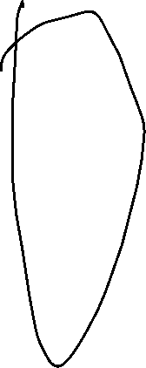







Let's go through an example of a truth table for a logical function
Let's consider a logical function that represents the following expression:
Output = (Input A AND Input B) OR (NOT Input C)
Here's the truth table for this logical function:
Input A | Input B | A AND B | Input C | Not C | Output
0 | 0 | 0 | 0 | 1 | 1
0 | 0 | 0 | 1 | 0 | 0
0 | 1 | 0 | 0 | 1 | 1
0 | 1 | 0 | 1 | 0 | 0
1 | 0 | 0 | 0 | 1 | 1
1 | 0 | 0 | 1 | 0 | 0
1 | 1 | 1 | 0 | 1 | 1
1 | 1 | 1 | 1 | 0 | 1

Slide 16
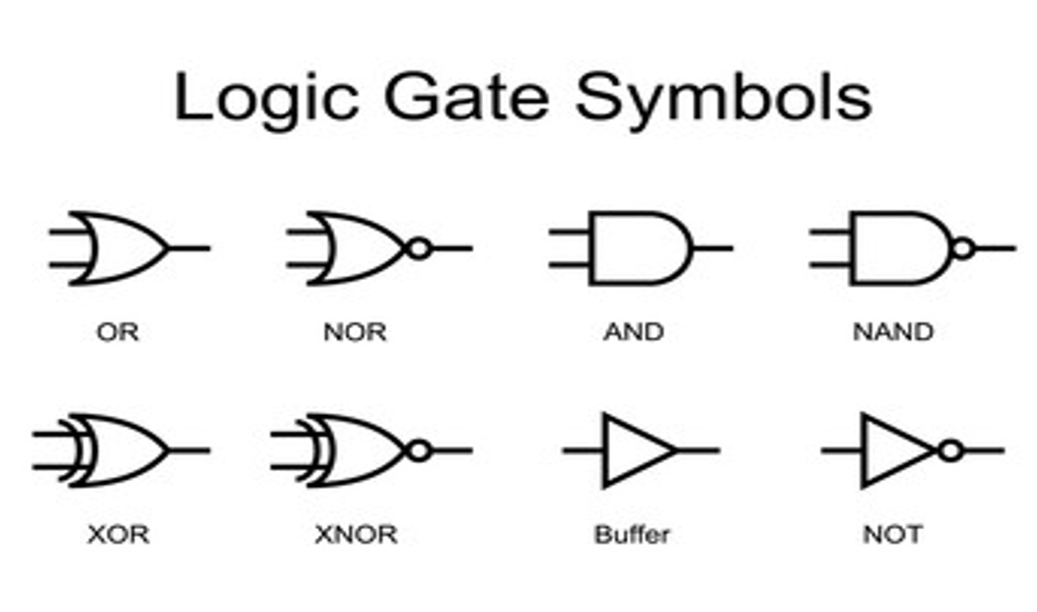






Logical Gates

Slide 17
Basic theorems of Boolean algebra
Identity Theorems:
Identity Law: A + 0 = A and A * 1 = A. Adding 0 to a variable or multiplying it by 1 does not change its value.
Null Law: A + A' = 1 and A * A' = 0. The sum of a variable and its complement is always 1, and the product is always 0.
Idempotent Theorems:
Idempotent Law: A + A = A and A * A = A. Repeating an operation with the same variable does not change its value.
Complement Theorems:
Complement Law: A + A' = 1 and A * A' = 0. The sum of a variable and its complement is always 1, and the product is always 0.
Double Complement Law: (A')' = A. The complement of the complement of a variable is the variable itself.
Commutative Theorems:
Commutative Law of Addition: A + B = B + A. The order of variables does not affect the outcome of addition.
Commutative Law of Multiplication: A * B = B * A. The order of variables does not affect the outcome of multiplication.

Slide 18
Basic theorems of Boolean algebra
Associative Theorems:
Associative Law of Addition: (A + B) + C = A + (B + C). The grouping of variables in addition does not affect the outcome.
Associative Law of Multiplication: (A * B) * C = A * (B * C). The grouping of variables in multiplication does not affect the outcome.
Distributive Theorems:
Distributive Law of Multiplication over Addition: A * (B + C) = (A * B) + (A * C). Multiplication distributes over addition.
Distributive Law of Addition over Multiplication: A + (B * C) = (A + B) * (A + C). Addition distributes over multiplication.
Absorption Theorems:
Absorption Law: A + (A * B) = A and A * (A + B) = A. A variable combined with a logical product (AND) or logical sum (OR) involving itself reduces to the variable itself.
A | B | A * B | A + (A * B)
0 | 0 | 0 | 0
0 | 1 | 0 | 0
1 | 0 | 0 | 1
1 | 1 | 1 | 1

Slide 19
Basic theorems of Boolean algebra
Distributive Theorem (Dual):
Dual Distributive Law of Addition over Multiplication: A * (B + C) = (A * B) + (A * C). Multiplication distributes over addition.
Involution Theorem:
Involution Law: (A')' = A. The double complement of a variable is equal to the variable itself.
De Morgan's Theorems (Dual):
De Morgan's First Theorem (Dual): NOT (A OR B) = (NOT A) AND (NOT B). The complement of a logical disjunction (OR) is equivalent to the logical conjunction (AND) of the complements of the individual parts.
De Morgan's Second Theorem (Dual): NOT (A AND B) = (NOT A) OR (NOT B). The complement of a logical conjunction (AND) is equivalent to the logical disjunction (OR) of the complements of the individual parts.
Absorption Theorems (Dual):
Dual Absorption Law: A * (A + B) = A and A + (A * B) = A. A variable combined with a logical sum (OR) or logical product (AND) involving itself reduces to the variable itself.
Redundancy Theorem:
Redundancy Law: A + A' * B = A + B. The presence of A' * B is redundant in the expression A + A' * B.
Consensus Theorem:
Consensus Law: (A + B) * (A' + C) * (B + C) = (A + B) * (A' + C). When two terms have a common variable and their complements form a term, that term can be factored out.

Slide 20
Thank you
Saroj Kumar Jha​
srojkrjha@gmail.com

